Slide 1


Slide 2

AIR BOOKING PREDICTION
Using Machine Learning Techniques
Guide : Sameer Warsolkar
Presented By : Asif Shaikh
Institute : IT Vedant
Course : DS&DA
Branch : Thane

Slide 3
Steps
Define the Problem(Problem Statement: Classification.
Data Loading.
Exploratory Data Analysis(EDA):-
Identification of variables and data types.
Graphical Univariate Analysis
Missing value treatment
Label Encoder
Seperation of x and y
Train Test Split
Choose a Model
Train the Model
Evaluate the Model
Model Deployment

Slide 4
Problem Statement
Air Booking Prediction: -
Data Collection and Preprocessing: Predict air booking demand by collecting and preprocessing historical data, including factors such as departure/arrival times, airline preferences, and seasonal trends.
Feature Engineering: Develop relevant features like day-of-week effects, holiday impact, and customer demographics to enhance the model's ability to capture patterns in air travel bookings.
Model Selection and Training: Choose a suitable machine learning model (e.g., regression, time series forecasting) and train it on the preprocessed data to accurately predict future air booking trends.
Evaluation and Optimization: Assess the model's performance using metrics like Mean Absolute Error (MAE) and continuously optimize it by incorporating new data and refining parameters for robust and reliable air booking predictions.

Slide 5
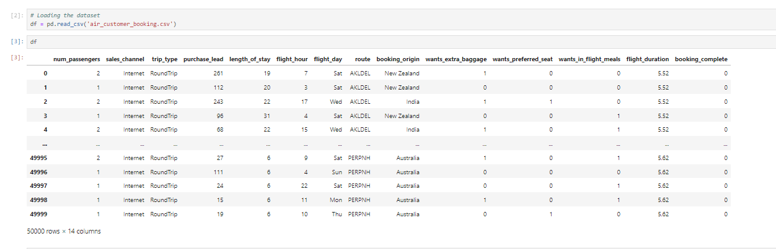
Data Collection

Slide 6
DATA DICTIONARY
num_passengers: Number of passengers for the air booking.
sales_channel: Channel through which the booking was made (e.g., online platform, travel agency).
trip_type: Type of trip (e.g., one-way, round trip).
purchase_lead: Lead time between booking and departure.
length_of_stay: Duration of the trip in days.
flight_hour: Time of the day for the flight.
flight_day: Day of the week for the flight.
route: Specific route of the flight.
booking_origin: Location or platform where the booking originated.
wants_extra_baggage: Indicator if the passenger wants extra baggage.
wants_preferred_seat: Indicator if the passenger prefers a specific seat.
wants_in_flight_meals: Indicator if the passenger wants in-flight meals.
flight_duration: Duration of the flight.
booking_complete: Indicator of whether the booking process is complete or not.

Slide 7
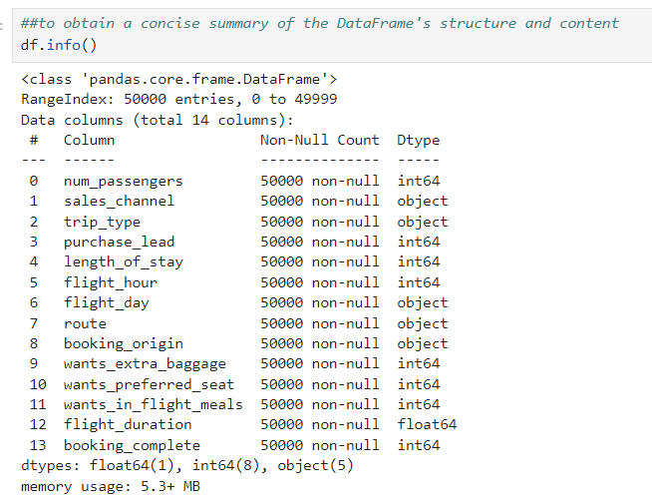
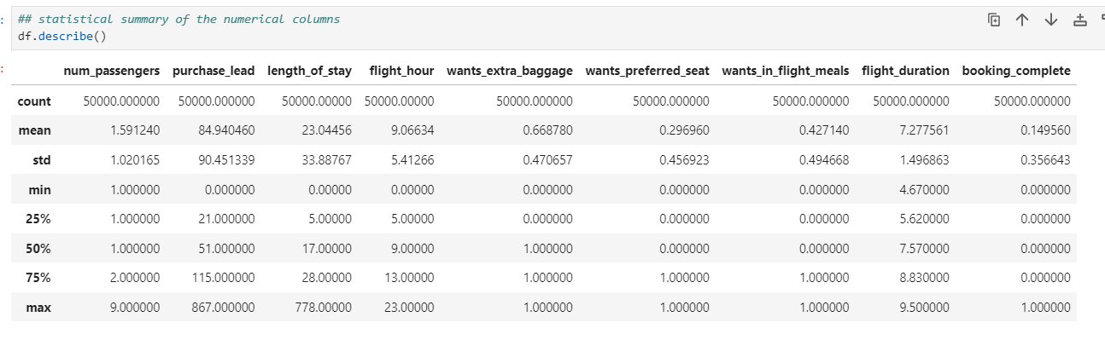
EDA
Identification of Variables and data types
Non-Graphical Univariate Analysis

Slide 8
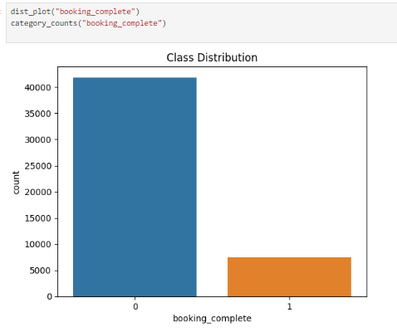
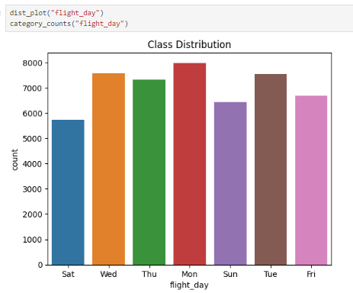
Graphical Representation
Booking Status
Flight Days

Slide 9
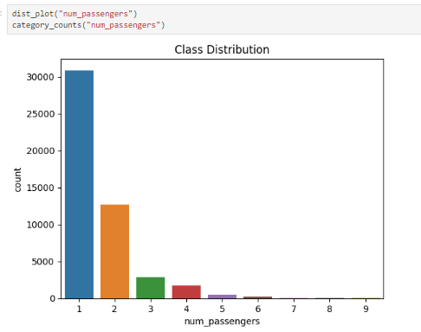
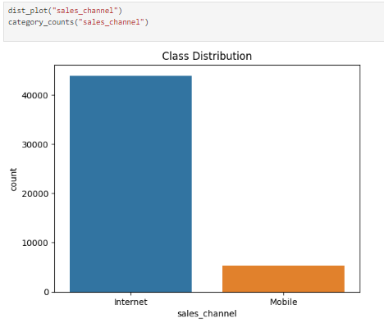
Number of Passenger
Sales Channel

Slide 10
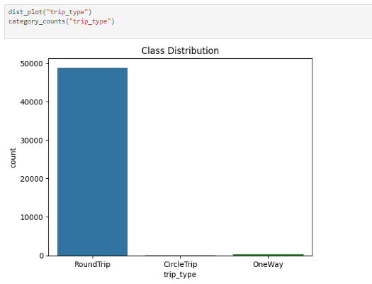
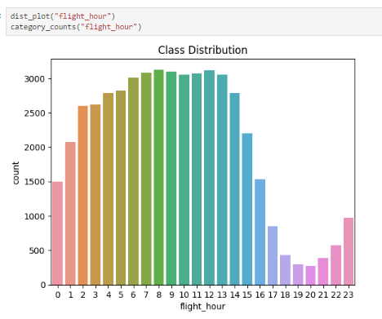
Types of Trips
Flights Hours

Slide 11
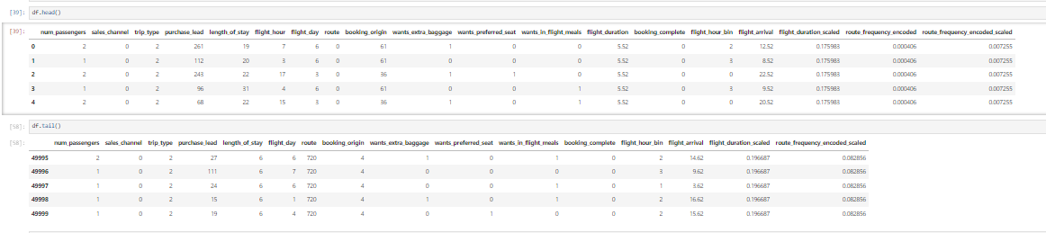
Data Cleaning
Head & Tail of DataFrame

Slide 12
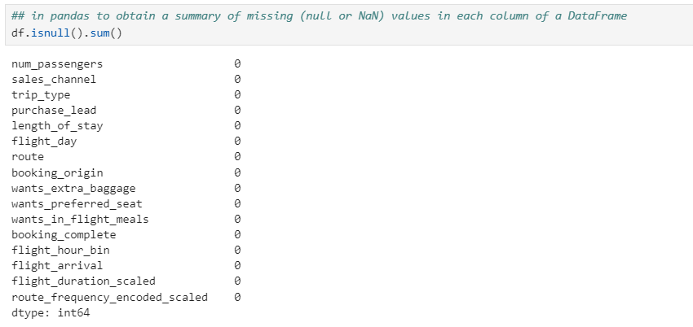
Null Values

Slide 13
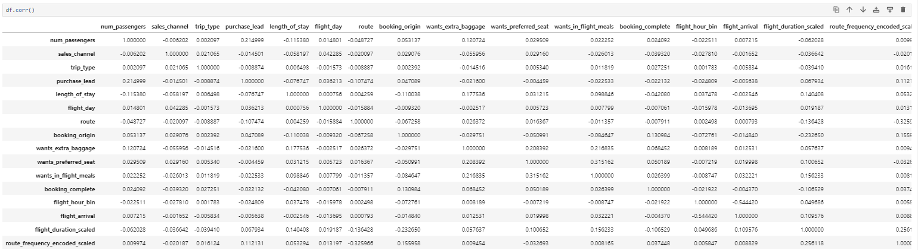
Correlations

Slide 14
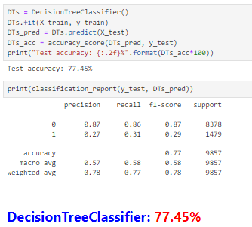
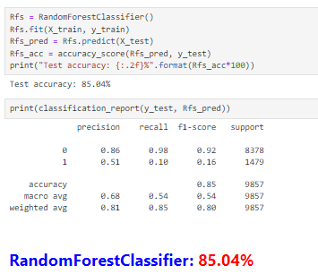
MODEL BUILDING
DecisionTreeClassifier
RandomForestClassifier

Slide 15
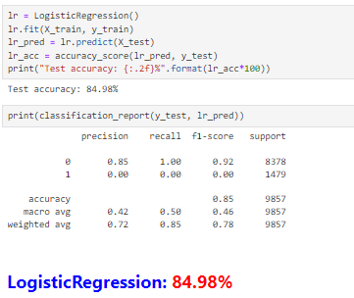
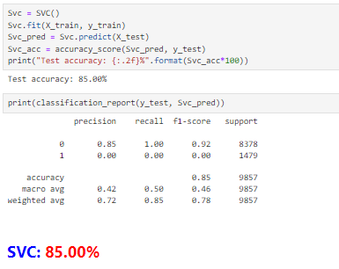
LogisticRegression
SVC

Slide 16
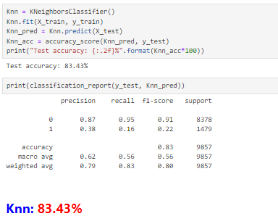
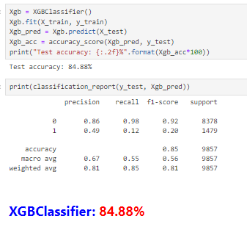
KNeighborsClassifier
XGBClassifier

Slide 17
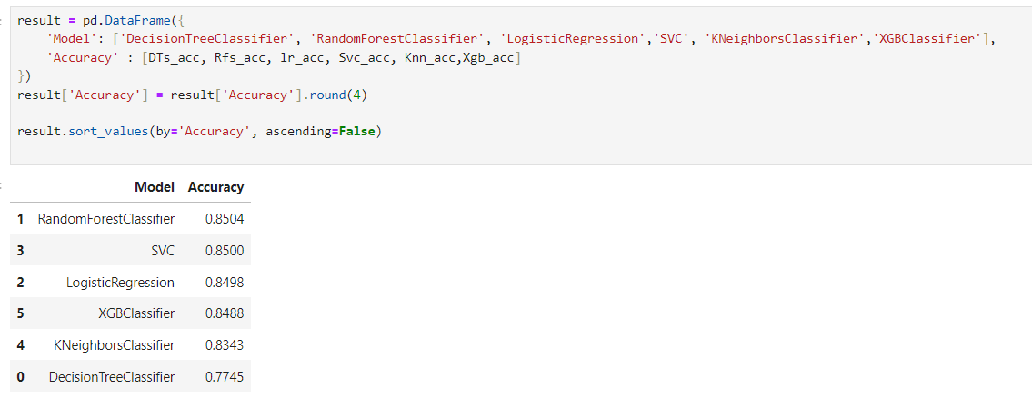
ALL MODEL IN ONE DATAFRAME

Slide 18
CONCLUSION
The order of the Best Models Accuracy from top to bottom is : RandomForestClassifier

Slide 19
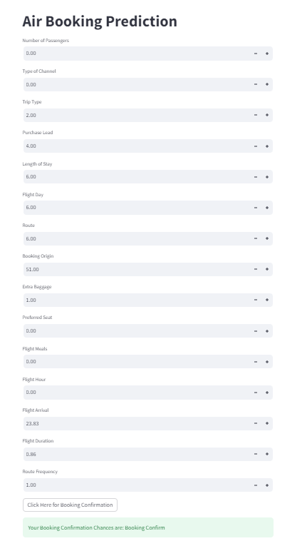
DEPLOYMENT
Tools and Libraries used-
Anaconda Navigator : Environment Creation
Pickle : Binary Conversion of data
Stream lit : Web App
Scikit-Learn : RandomForestClassifier Model

Slide 20


